Slide 2
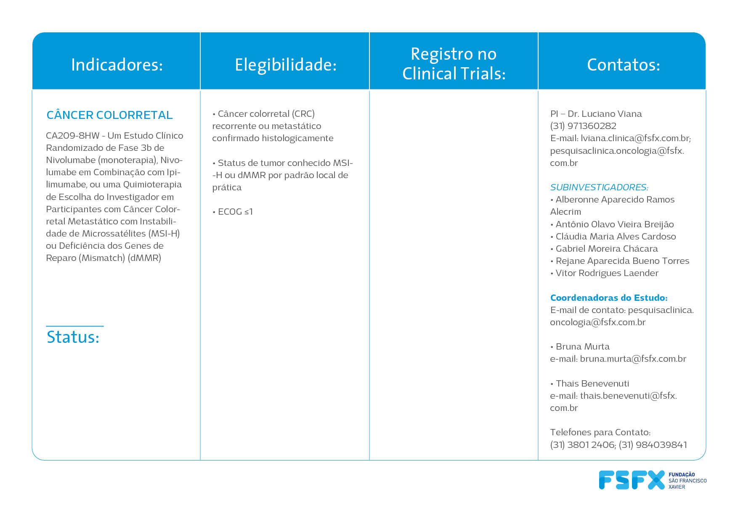
https://clinicaltrials.gov/ct2/show/NCT04008030
RECRUTAMENTO ABERTO

Slide 3
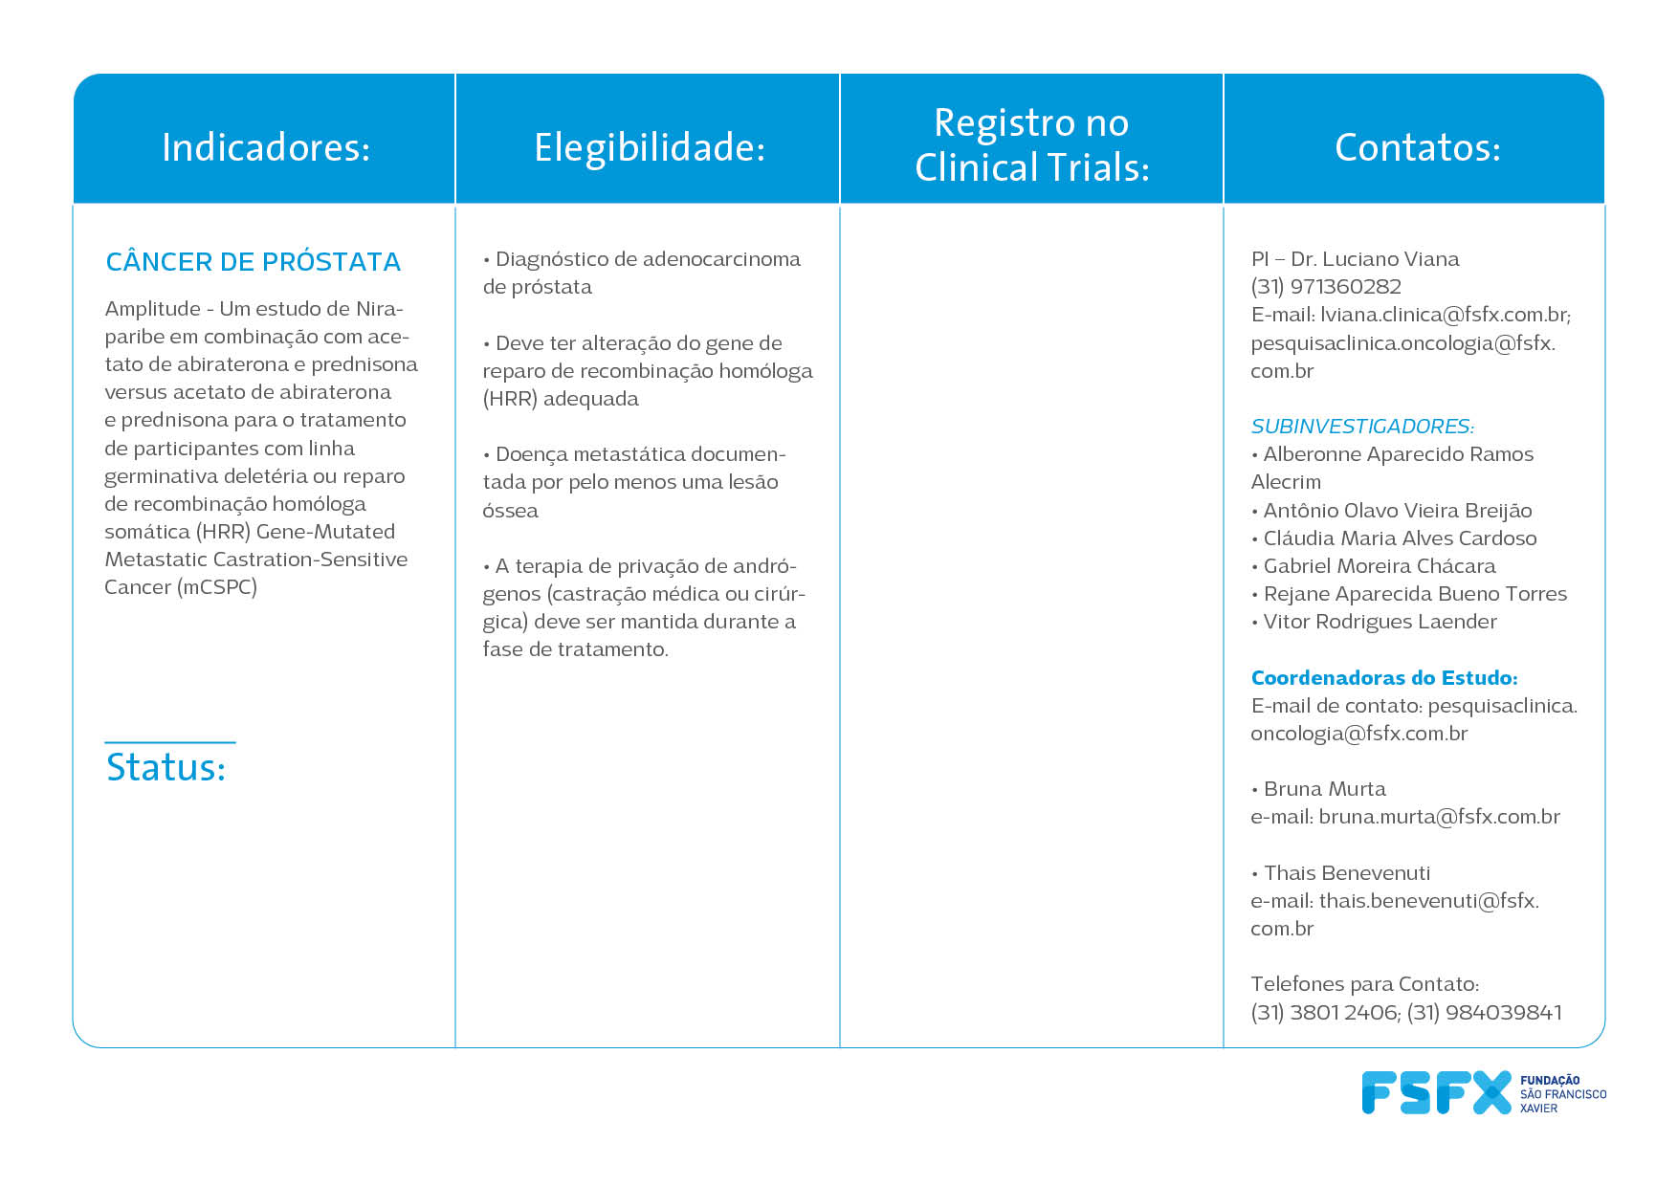
https://clinicaltrials.gov/ct2/show/NCT04497844
RECRUTAMENTO ABERTO

Slide 4
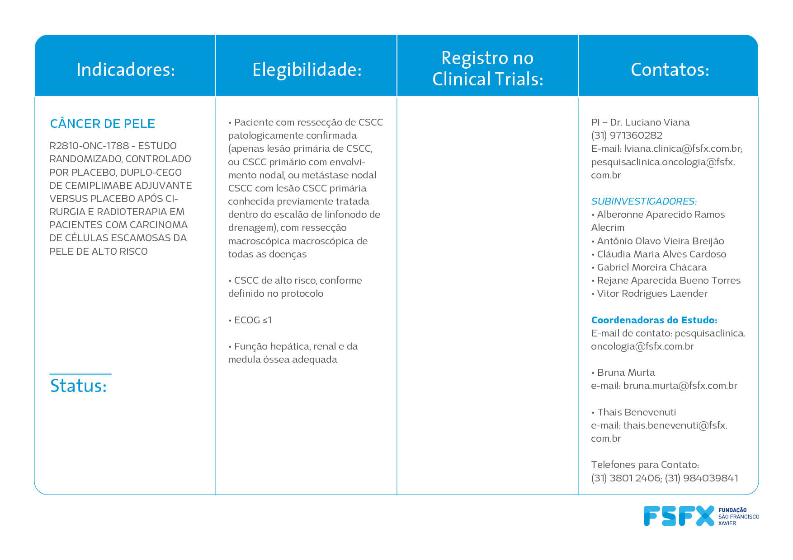
https://clinicaltrials.gov/ct2/show/NCT03969004
RECRUTAMENTO ABERTO

Slide 5
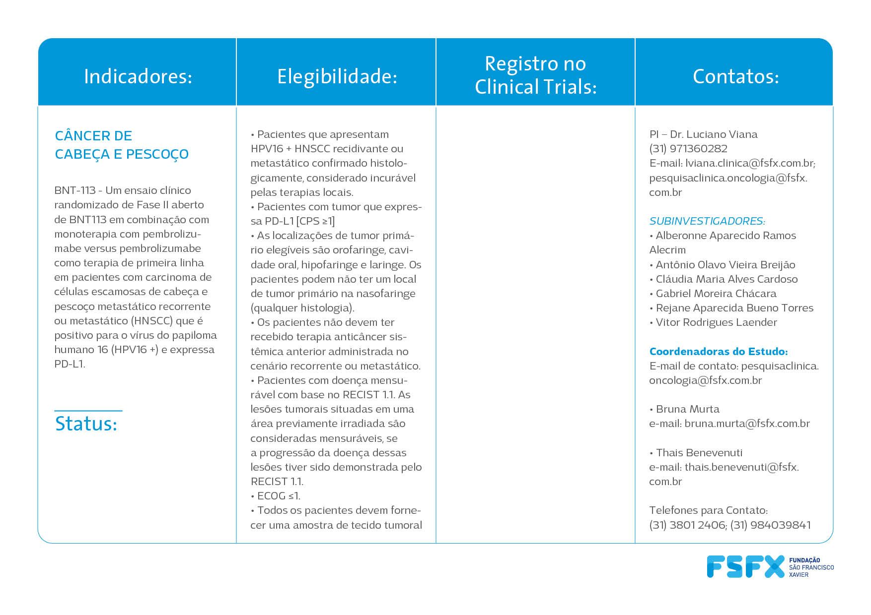
https://clinicaltrials.gov/ct2/show/NCT04534205
RECRUTAMENTO ABERTO

Slide 6
https://clinicaltrials.gov/ct2/show/NCT03765918?term=mk3475&recrs=a&type=Intr&age=12&phase=2&fund=2&draw=3&rank=24
RECRUTAMENTO ABERTO

Slide 7
https://clinicaltrials.gov/ct2/show/NCT04988295?term=61186372NSC3002&draw=1&rank=1
RECRUTAMENTO ABERTO

Slide 8
https://clinicaltrials.gov/ct2/show/NCT05388669
RECRUTAMENTO ABERTO

Slide 9
https://clinicaltrials.gov/ct2/show/NCT05261399?term=saffron&recrs=ab&type=Intr&age=12&phase=2&fund=2&draw=2&rank=1
RECRUTAMENTO ABERTO

